Slide 1
EXPLORING PATHWAYS, GENES AND GENE LISTS IN BIG BIOLOGICAL DATASETS
Alex Greenshields Watson
Cardiff University
SatRday 2019

Slide 2
Big Biological Data
Gene expression data
60,000 genes by 10,000 samples (TCGA)
“What are the cells & tumours & tissues doing?”
Survival Data & Meta Data
10,000 patients
“How long are people living? Treatment? What did they eat?”
Hypervariable Receptor Sequence Data
50 Grouped Character Vectors & Meta Data (Parent Genes)
c(“CAASGFRF”, “CASSAGGRLDF”, …)
Common Motifs & Sequence Patterns & Gene Linkages

Slide 3
Patients >>>>>>>>>>>>>>>>>>>>>>>>>>
-0.027282 | -0.0382812 | 0.13127112 | 0.01225686 | -0.0940001 | -0.002043 | 0.04434419 | 0.01431537 | 0.11371493 | -0.0474045 | 0.00236726 | -0.038656 | -0.0057113 | 0.01208091 | -0.0591419
-0.0731766 | -0.1339181 | -0.0564921 | -0.0535433 | 0.04740453 | 0.07893062 | 0.04425263 | -0.0416944 | 0.00177455 | 0.03372884 | 0.02574325 | -0.0017745 | -0.1014984 | 0.05727172 | -0.0298965
0.18086815 | -0.1120086 | -0.0282874 | -0.1045461 | -0.1393399 | -0.1114697 | 0.31011868 | 0.1428709 | -0.1481104 | 0.33694935 | 0.1024394 | 0.02828741 | 0.11682463 | 0.11338854 | -0.1019216
-0.6646657 | 0.10306597 | -0.3290763 | 0.3331437 | -0.0926709 | 0.43367052 | 0.43101263 | 0.3193078 | 0.80060244 | -0.1301179 | -0.0988011 | -0.0214725 | -0.5037284 | 0.02147245 | 0.02887201
0.08848095 | 0.05566931 | -0.0725808 | 0.02415037 | 0.07183981 | 0.01576805 | -0.0266633 | 0.14721584 | -0.0247469 | -0.0782595 | -0.0157681 | -0.0845723 | -0.022747 | -0.0640183 | 0.0477066
-0.0948441 | -0.0370052 | 0.07220054 | -0.0663211 | 0.00275874 | 0.08778215 | -0.0027587 | -0.0103829 | -0.0330303 | -0.0207274 | 0.01976562 | 0.06319594 | 0.00687051 | 0.03611207 | -0.0201895
0.01185942 | 0.05386639 | 0.00759888 | -0.068511 | -0.0424981 | -0.0454011 | 0.05207443 | 0.03530836 | -0.0075989 | -0.0380225 | -0.0114503 | 0.03728056 | 0.00938892 | -0.0600371 | 0.01144886
0.01309013 | -0.0571589 | 0.07522011 | 0.11242724 | 0.02002335 | 0.14194632 | -0.1450033 | -0.018353 | 0.01009035 | -0.0848269 | 0.10012913 | -0.0426927 | -0.0100904 | -0.0296021 | 0.07638598
-0.3697848 | 0.710598 | -0.0042257 | 0.19000149 | 0.15832901 | 0.07054615 | -0.4735546 | 0.36975193 | 0.09186029 | -0.5257506 | -0.0951285 | 0.00422573 | -0.306129 | 0.6520939 | -0.5315285
-0.0541677 | 0.06490707 | 0.01160383 | 0.03805208 | 0.05341625 | -0.0125165 | 0.10338688 | -0.1067758 | -0.0113564 | 0.02191258 | -0.0032959 | -0.0711942 | 0.0032959 | -0.0048165 | 0.02104092
-0.3857384 | -0.0395942 | -0.0768957 | -0.0051074 | 0.14705801 | 0.20743465 | 0.3803239 | 0.25098562 | -0.089066 | 0.1917224 | -0.0189047 | 0.08451891 | 0.0270977 | -9.86E-04 | 9.86E-04
-0.2244616 | -0.1256442 | -0.0347638 | -0.1341171 | 0.17739582 | 0.01995325 | 0.18457127 | 0.2260499 | -0.096446 | 0.06278992 | -0.0261955 | 0.1690073 | 0.11517191 | -0.0199533 | 0.11423588
-0.0735583 | -0.0611763 | 0.016078 | -0.016078 | 0.22695494 | 0.17423582 | 0.32920027 | 0.07732773 | -0.159965 | -0.2340841 | -0.1111302 | 0.10605431 | 0.03579044 | 0.05585194 | -0.0622349
-1.0746412 | -0.3357191 | -0.3619146 | -0.1863346 | -0.100215 | 0.16961288 | 0.22533798 | 0.08587265 | -0.0915251 | 0.26663303 | 0.2634201 | 0.04311752 | 0.20323753 | 0.16326809 | -0.0431175
-0.1002188 | -0.2339864 | -0.0010095 | 0.09060335 | -0.1050797 | 0.3232174 | 0.1721754 | 0.08162689 | 0.15953016 | 0.05235577 | -0.2623377 | -0.4161711 | 0.00100946 | -0.2900672 | -0.0866385
0.04733419 | -0.048883 | -0.0276089 | -0.1030636 | -0.0591497 | 0.04077435 | 0.19933796 | 0.16578007 | -0.0816274 | 0.13084698 | -0.0216966 | 0.02364349 | -0.196765 | 0.02169657 | -0.0376401
-0.4503427 | -0.1368976 | -0.6557183 | -0.0152459 | 0.01524591 | 0.17514944 | 0.5949187 | 0.12616777 | -0.1508088 | 0.26059675 | 0.12211657 | -0.1423841 | 0.41848326 | 0.23265505 | -0.5700355
-0.3181443 | -0.0078883 | -0.6101127 | 0.00788832 | 0.13878202 | 0.17113733 | 0.1124301 | -0.203197 | 0.0343194 | -0.018703 | 0.12409067 | -0.0152822 | 0.21157217 | 0.14289427 | -0.5384431
-0.2630148 | 0.00134182 | -0.0741015 | -0.1839428 | -0.0017977 | -0.3962908 | -0.0013418 | 0.09418392 | -0.4512472 | 0.0690403 | 0.21308327 | 0.30299568 | 0.06941414 | 0.20223999 | 0.34776688
-0.7608814 | -0.0463371 | -0.2058554 | -0.0232162 | 0.10161591 | 0.1012125 | 0.08244801 | 0.09937191 | 0.02321625 | -0.1978054 | 0.09505367 | -0.0300446 | -0.0356808 | -0.0479393 | 0.10971546
-0.4373701 | -0.1096704 | -0.1665318 | 0.20672345 | -0.0473111 | 0.44678998 | -0.0378382 | 0.46527028 | 0.5620377 | 0.03783822 | 0.29479337 | -0.6763532 | 0.44067025 | 0.05605435 | -0.2110441
0.34102917 | -0.3245001 | -0.4598947 | -0.058392 | 0.10160446 | -0.1982422 | 0.24601078 | 0.32004833 | -0.0361576 | -0.1141205 | 0.01722622 | 0.30069923 | -0.0172262 | 0.10435963 | 0.0888586
-0.0522997 | 0.07551694 | 0.07743478 | -0.0455349 | -0.0157001 | 0.07475114 | -0.0038316 | -0.0526869 | 0.10881639 | -0.0106614 | 0.05063033 | 0.20653701 | -0.0654743 | -0.0238121 | 0.00383163
0.17596054 | 0.01981163 | 0.0457921 | -0.1461282 | -0.023798 | -0.0370946 | 0.00115919 | 0.08254337 | -0.1675015 | 0.12142801 | -0.0498776 | 0.04094076 | -0.1872163 | -0.0011592 | 0.01209784
0.27476883 | 0.08389759 | -0.1017652 | 0.00510073 | 0.07945824 | 0.02648449 | -0.127851 | -0.1038804 | -0.0101671 | -0.1161356 | -0.0665073 | 0.07548571 | -0.0781713 | -0.0051007 | 0.01501513
0.05355716 | 4.15E-04 | -4.15E-04 | -0.069732 | -0.0748756 | -0.0412295 | -0.0748961 | 0.02217317 | -0.0823224 | 0.12264705 | -0.0295923 | 0.0625155 | 0.02070975 | 0.05533338 | 0.00331283
0.06647229 | 0.05664659 | 0.03072572 | 0.1602838 | -0.0640209 | -0.0067542 | -0.1387279 | 0.00317073 | 0.05924964 | -0.0406606 | -0.0464084 | 0.00138354 | -0.0013835 | -0.0068743 | -0.0692699
-0.2344892 | -0.307533 | -0.3643601 | -0.3201397 | -0.1408608 | 0.14150262 | -7.77E-04 | -0.2199233 | 0.26427674 | 0.28082442 | 0.09692597 | 0.04186559 | 0.19309163 | -0.1395757 | 0.04946113
0.31403995 | -0.03145 | -0.0898502 | 0.05214381 | 0.10070252 | -0.0562232 | -0.0200336 | 0.14665675 | 0.05031562 | -0.1173451 | 0.06110787 | -0.0212843 | 0.14626956 | -0.0821092 | -0.035342
0.03994894 | 0.04744148 | -0.0223656 | -0.0032954 | -0.0451713 | 0.00329542 | -0.0192275 | -0.0286155 | -0.0066652 | -0.0551939 | -0.0034566 | 0.00742292 | 0.03844261 | 0.01026344 | 0.01305914
0.6958287 | 0.01275802 | -0.291589 | 0.18362308 | 0.10867238 | -0.0839598 | -0.2250106 | 0.53016067 | 0.00446916 | -0.0490825 | -0.197386 | 0.08403945 | -0.0044692 | -0.0413559 | -0.1032503
-0.0793483 | 0.07320428 | 0.11358523 | 0.01984716 | -0.0333698 | 0.02702832 | 0.05191922 | -0.0113499 | 0.03106332 | -0.0414073 | -0.0709522 | 0.00866008 | -0.0522473 | -0.0086601 | 0.02642369
0.03595829 | -0.0925169 | -0.0310049 | 0.00931025 | -0.0320468 | -0.0222087 | -0.0252752 | 0.1162076 | -0.0070763 | 0.03658629 | 0.00707626 | 0.16408968 | -0.0780549 | -0.0426936 | 0.00999498
-0.0077679 | 0.002846 | 0.03177238 | -0.1051276 | -0.0415356 | -0.002846 | 0.04032254 | 0.07456231 | 0.01427054 | -0.0034521 | -0.0520756 | 0.06233335 | 0.00853038 | -0.0423024 | 0.0494225
-1.3085074 | -0.0850573 | -0.0207787 | -0.1699209 | -0.0295935 | 0.08774471 | 0.4606142 | 0.02077866 | -0.1074829 | 0.04274654 | 0.09717369 | 0.25776196 | 0.03867626 | -0.2654352 | -0.069088
-0.2348428 | -0.0126643 | -0.2504344 | -0.0960698 | 0.12198305 | -0.2344737 | 0.3943858 | -0.1625552 | -0.1954036 | 0.04103613 | 0.16111708 | 0.01266432 | -0.0143132 | 0.15262747 | 0.12780523
-0.093914 | -0.0065107 | -0.2084713 | 0.02006054 | 0.26020813 | 0.20386887 | -0.0161734 | -0.251092 | 0.2569914 | -0.3565817 | -0.0461903 | 0.25661182 | -0.0264053 | 0.36386395 | 0.00651073
-0.0830021 | 0.41222763 | -0.0796375 | -0.7892647 | -0.4703789 | 0.02077389 | -0.5024662 | -1.6104279 | -0.4678288 | 0.66626644 | 0.7649555 | 0.27865028 | 0.5987358 | -0.0207739 | 1.25138
0.18110037 | -0.333508 | -0.4819303 | -0.2296681 | 0.01679277 | 0.12922525 | 0.38616514 | -0.0167928 | -0.2608247 | 0.19891691 | 0.05117655 | 0.11814737 | 0.09964705 | -0.0601344 | -0.3505712
0.1498878 | -0.2713921 | -0.0300515 | 0.18735099 | -0.1065528 | 5.54E-04 | 0.08024669 | -0.0758016 | -0.1791942 | -0.3666561 | 0.01995635 | -0.0654805 | 0.08334231 | 0.25448775 | 0.501271
0.02617526 | 0.1789434 | -0.0518768 | -0.0063641 | 0.16413903 | 0.13382411 | 0.19752908 | -0.2104991 | 0.32994342 | 0.03354144 | -0.032069 | 0.00636411 | -0.3023655 | -0.0655701 | -0.0560243
0.07592368 | 0.00152755 | -0.0015275 | 0.06540656 | -0.0445035 | -0.01177 | -0.0314968 | -0.0236633 | 0.0064013 | 0.06451726 | 0.18818116 | 0.28383088 | 0.01633191 | -0.127557 | -0.0523965
0.43832684 | 0.7407465 | 0.7397804 | -0.2469368 | -0.0650272 | 0.41160774 | 0.13566399 | 0.34576607 | -0.6578069 | 0.06502724 | -0.0924683 | -0.7276835 | -0.9946723 | -0.0798254 | -0.2326355
-0.28297 | -0.2147999 | -0.1215224 | -0.1815176 | 0.09754992 | 0.15948343 | 0.1416645 | 0.16380358 | -0.0320373 | 0.32006645 | -0.0339241 | 0.0206809 | 0.21580982 | 0.05845451 | -0.0206809
0.05315089 | -0.0084465 | 0.08804822 | -0.0213692 | -0.0666716 | 0.07624698 | -0.0764849 | 0.00248885 | -0.0750821 | -0.0623157 | -0.0199945 | 0.20012736 | 0.04468465 | 0.0188973 | -0.0024889
0.02835417 | -0.0028849 | 0.00288486 | -0.1633859 | 0.0963912 | -0.0054522 | 0.13876486 | -0.0047841 | -0.0238709 | -0.0670853 | 0.02568293 | 0.5245228 | -0.0377569 | 0.01223373 | -0.0167408
-0.4403603 | 0.44509292 | 0.28512645 | -0.0538013 | -0.0416057 | 0.3099501 | -0.28495 | 0.21458983 | -0.1520426 | -0.1797683 | 0.13129401 | 0.08307624 | 0.11823297 | -0.4431121 | 0.04160571
0.7294247 | -0.1707938 | -0.1142728 | -0.308933 | -0.1546648 | -0.2461903 | -0.3250144 | -0.0375583 | 0.03755832 | 0.4790094 | 0.45041347 | 0.6752722 | 0.5272615 | 0.16893649 | 0.07218957
0.05836034 | 0.06236672 | -0.0177047 | 0.02276206 | -0.1046908 | -0.1979125 | 0.05989432 | -0.0466969 | 0.05780006 | 0.04733205 | -0.0516865 | 0.14649367 | -0.0730283 | -0.0659411 | 0.01303458
0.38887024 | 0.04584026 | 0.03330517 | -0.0854759 | 0.03330517 | -0.183548 | -0.0333052 | -0.1713123 | -0.4735518 | -0.0542555 | -0.4219923 | 0.28533745 | -0.1003656 | 0.15500164 | 0.09941769
0.01107931 | 0.04004574 | -0.1231732 | 0.13058901 | -0.0317822 | 0.01314783 | -0.1110597 | 0.05886221 | 0.06801462 | -0.0505438 | -0.0216622 | 0.00281096 | -0.1019449 | -0.002811 | 0.0240674
-0.0308371 | 0.01141548 | 0.0261178 | 0.04212952 | -0.0909891 | -0.1318631 | -0.0114155 | 0.13529253 | -0.0966687 | -0.0125213 | -0.0378914 | 0.03722858 | 0.01765728 | 0.05705023 | -0.0237675
0.01503849 | -0.0064406 | 0.03753853 | -0.0494695 | -0.0391779 | 0.00361204 | 0.04221487 | 0.03870058 | 0.03000307 | 0.06705141 | 0.11211252 | -0.025229 | -0.1221919 | -0.003612 | -0.0535159
1.3085008 | 0.06443167 | -0.0117435 | 0.01267529 | 0.0120616 | 0.00640774 | -0.0050168 | -0.0955954 | 0.0050168 | -0.0338845 | -0.0534315 | -0.0487394 | -0.0254531 | 0.08701372 | 0.06002426
0.38937926 | 0.07598758 | 0.170717 | -0.0582945 | -0.1222804 | -0.0062096 | 0.04403806 | -0.1116769 | 0.0205853 | 0.00620961 | -0.0700672 | -0.0858729 | 0.00725579 | -0.0683429 | -0.0159147
-0.3826318 | 0.03943491 | 0.13432121 | 0.03853655 | -0.1138635 | 0.18135262 | -0.401876 | 0.0536747 | 0.7182312 | -0.0427156 | -0.0499597 | -0.3229098 | 0.03637314 | -0.0032578 | 0.00145626
0.05927301 | 0.00402808 | 0.01751161 | 0.05468535 | 0.09715533 | -0.0040281 | -0.0824091 | -0.053335 | 0.03833461 | -0.1113222 | -0.0188286 | 0.05903792 | -0.0786936 | -0.0171263 | 0.01033568
-0.5054393 | 0.00709534 | -0.251081 | 0.17136669 | 0.16071701 | 0.11753368 | 0.10688686 | -0.0608139 | 0.42046452 | -0.0685039 | -0.0169477 | -0.0018072 | -0.0367212 | 0.00180721 | -0.1515794
-0.1168127 | -0.0266175 | -0.0747933 | -0.0798187 | 0.0313735 | -0.0138688 | 0.274436 | 0.07469273 | 0.07985544 | -0.0221996 | -0.1346765 | 0.02817059 | 0.01386881 | 0.02508164 | -0.1604075
-0.7350941 | -0.314723 | -0.384263 | -0.0021172 | -0.0449152 | 0.29775047 | 0.3723135 | 0.14178085 | -0.2992573 | 0.35617447 | 0.04742622 | 0.00211716 | 0.09952545 | 0.05536652 | -0.1972599
-0.0503163 | 0.00435829 | 0.00911665 | 0.02029276 | -0.08322 | 0.02806425 | 0.06012392 | 0.08094549 | -0.0188546 | -0.1428671 | -0.0043583 | -0.0599618 | -0.175323 | 0.05159855 | -0.0378323
-0.0100956 | -0.035955 | -0.0161624 | -0.0296779 | 0.05345583 | -0.0248938 | 0.06831455 | -0.0043535 | 0.05572557 | 0.00720644 | 0.14727736 | 0.04163551 | 0.12546778 | 0.00435352 | -0.0105772
0.23372889 | -0.0079441 | -0.0194922 | 0.00254917 | 0.05711651 | -0.0227718 | 0.12846994 | 0.03369093 | -0.1561141 | -0.0025492 | 0.04324961 | 0.01972246 | 0.14972973 | -0.0514069 | -0.0420122
0.22440577 | 0.01065397 | -0.2026858 | -0.0535693 | 0.17621946 | -0.0236945 | -0.010654 | -0.0636973 | -0.1638513 | 0.0272193 | 0.05409479 | 0.20259237 | 0.07078791 | 0.28990698 | -0.0381122
0.14336348 | 0.04193735 | -0.228868 | 0.00553465 | 0.11195993 | -0.0055346 | -0.0448184 | 0.19341707 | -0.2970023 | 0.04675436 | -0.056314 | -0.0123725 | 0.3214984 | 0.29299212 | -0.0995202
-0.2099328 | -0.0874019 | -0.1622014 | 0.01134539 | 0.11118269 | -0.1852479 | 0.03641844 | -0.0046201 | 0.10503054 | -0.1147895 | 0.00241995 | -0.0024199 | 0.19977522 | 0.05382872 | -0.2441821
-0.0777283 | -0.1258459 | -0.2248306 | 0.0293932 | -0.1599407 | 0.1057806 | 0.61875725 | 0.6733484 | -0.0293932 | 0.74503803 | 0.42073536 | -0.1690941 | 0.43499756 | 0.2505045 | -0.3689928
-1.2393131 | -0.2679071 | -0.8424912 | 0.43906975 | 0.2154417 | 0.32578373 | 0.83918 | -0.1519814 | 0.5304127 | 0.1783123 | 0.24772453 | -0.5790577 | 0.15198135 | -0.2538748 | -0.4088516
0.02223444 | 0.09233809 | -0.0163121 | 0.00596762 | -0.1421561 | -0.0096126 | -0.0561676 | 0.01503658 | -0.0476866 | 0.04508638 | -0.0149069 | 0.07794809 | -0.017633 | 0.17930794 | -0.0059676
0.00470924 | 0.02578735 | 0.02257967 | -0.0313578 | 0.01380062 | -0.0213289 | -0.0047092 | 0.08416796 | -0.0483494 | 0.13882732 | -0.0444298 | -0.090404 | 0.03692627 | -0.0733905 | 0.01619768
-0.521184 | -0.1774178 | 0.00485992 | 0.3256626 | -0.0048599 | -0.1573267 | 0.80751324 | 0.49374866 | -0.0099926 | 0.7304516 | -0.062645 | 0.38009167 | 0.66250896 | 0.27084827 | -0.0517988
-0.6186819 | 0.01845551 | -0.0965748 | 0.54906845 | -0.0662756 | -0.0184555 | 0.31175518 | 0.04073906 | 0.611887 | 0.45847988 | -0.107935 | 0.10294056 | 0.49876976 | -0.0545578 | -0.2412949
-0.3419597 | -0.0441473 | -0.0927427 | 0.26438832 | 0.10893035 | 0.08806157 | -0.2691367 | 0.0658977 | 0.28662372 | -0.0063899 | 0.0841229 | -0.0207484 | 0.00638986 | -0.2614243 | 0.02586961
-0.8411889 | -0.3112607 | -0.7107253 | 0.3056388 | -0.1847043 | 0.25147772 | 0.17002058 | 0.26026106 | 0.20759058 | 0.07217646 | 0.17318296 | -0.1051154 | 0.38772726 | -0.5674434 | -0.0721765
-0.1343901 | 0.01511836 | -0.0151184 | -0.1012032 | 0.03308415 | 0.08362651 | -0.0729573 | -0.0668156 | 0.0547092 | -0.124882 | -0.2583597 | 0.11622644 | 0.02885652 | -0.0622051 | 0.02723956
-0.4372757 | -0.3269227 | -0.3569276 | 0.13583875 | -0.0454395 | 0.13322854 | 0.11256146 | 0.0779345 | 0.04065299 | 0.06719756 | 0.15174317 | -0.2838271 | 0.18345094 | -0.1303637 | -0.040653
-2.7494874 | -0.0515742 | 0.5311742 | 0.05157423 | -0.5812316 | -1.2776818 | 0.98049784 | 0.57061243 | -0.3847175 | 0.9134507 | -0.1715369 | 0.35502672 | 0.35502672 | 0.09306765 | -0.5258527
-2.6839848 | -0.0628033 | 0.6884308 | 0.1387825 | -0.3876152 | -0.9918709 | 0.90886974 | 0.6366472 | -0.3897934 | 0.9620085 | -0.0209026 | 0.34522915 | 0.7261162 | 0.02090263 | -0.5384359
-0.2227774 | 0.37563038 | 0.08576012 | -0.3817825 | 0.3871565 | 0.13676071 | 0.64200115 | 0.9243994 | -0.0279293 | -0.1102867 | -0.0393486 | 0.7132473 | -0.0279293 | -0.0279293 | 0.02792931
1.5525432 | 0.6713834 | -0.6116738 | 1.2818198 | 0.48755312 | 0.6222663 | -0.575233 | -0.5244975 | 0.7875581 | -0.286345 | -0.3388753 | 0.17737722 | -0.3184648 | -0.1773772 | -0.1840882
0.08991003 | 0.07122707 | -0.057941 | 0.15947533 | 0.03797722 | 0.1275382 | 9.82E-05 | -0.0431581 | 0.18434668 | -0.1590343 | -0.0021195 | -0.0023808 | 0.16629362 | -0.0987887 | -9.82E-05
1.431293 | 0.03266954 | -0.0924888 | 0.17551184 | 0.14299726 | 0.00425148 | 0.03375101 | -0.0286317 | -0.1696725 | -0.1158867 | -0.0889754 | 0.00142527 | -0.0929923 | -0.0792055 | -0.0014253
-0.0558085 | -0.0441709 | 0.014081 | 0.01092958 | -0.0010681 | 0.0343976 | 0.00196314 | -0.0840626 | -0.0676513 | -0.0573945 | 0.02305508 | 0.00106812 | -0.0367961 | -0.0595841 | 0.02186346
0.05958223 | -0.0266643 | 0.03099203 | 0.00699377 | 0.0026226 | 0.00485754 | -0.0789709 | 0.00182438 | -0.0018244 | -0.0494952 | 0.04778099 | -0.1316638 | 0.04216528 | -0.0686374 | -0.0675521
0.77714515 | -0.0035303 | -0.0883315 | 0.06941581 | -0.0157974 | 0.1177547 | -0.2400086 | -0.0339472 | 0.03676534 | -0.080363 | 0.00353026 | -0.1219265 | 0.10738063 | -0.1697681 | 0.14246106
-0.0157688 | -0.1007774 | -0.0371449 | -0.0692165 | 0.03064704 | -0.0815928 | 0.13684869 | 0.11582542 | -0.1235826 | 0.0198977 | -0.0409391 | 0.09388232 | 0.25727963 | 0.01576877 | 0.02141023
5.67E-05 | 0.00685072 | -0.0341692 | 0.04984283 | 0.02336597 | -0.0137863 | 0.21699572 | -5.67E-05 | -0.0288382 | -0.0921402 | -0.0743642 | 0.0931983 | -0.0295801 | -0.0838351 | 0.00380373
-0.0943275 | 0.02192116 | -0.0867677 | -0.0531712 | -0.0070949 | 0.09364462 | -0.0224338 | -0.0930219 | -0.0069141 | -0.0419621 | 0.03633547 | 0.07989502 | 0.00691414 | 0.06511211 | 0.06291628
0.15966606 | -0.0850277 | -0.5269461 | -0.0254354 | -0.1809902 | 0.5240307 | 0.29651833 | 0.03781986 | -0.0660658 | 0.21056461 | 0.45349503 | -0.1656351 | 0.30668163 | 0.02543545 | -0.045166
Genes >>>>>>>>>>>>>>>>>>>>>>>>>>

Slide 4
CAISERAIRGTSGLTDTQYF
CAISECAIRGTSGLTDTQYF
CAISERAIRGTSGLTDTQYL
CASSQAAGGRAFF
CASSQAEGGQNHF
CASSLAPGGIAFF
CASSQAAGGRAIF
CASSLDSGFLEQYF
CAISESGGRVDEQYF
CASSPPSSYNEQFF
CASSLQGAPEQFF
CTSRLDPGFLEQYF
CASSLYGEYEQYF
CASSQGTTDTQYF
CASRPGQGGYEQY
CASSSSTGQQPQH
CASRTQRWETQY
CASSLAQGWKTQY
CASSIQGLRATNEKLF
CASRSPLGYEQY
CASSSGTSGSAGYNEQF
CASSTNNEQF
CASRTQRWETQY
CASSQGPGERAGFNYEQY
CASSLGYGYT
CASSKGRYNEQF
CASPHPDRPNYGYT
CASGGEFYGYT
CASSLTYGYT
CASSSRTGGYGYT
CATSDRMDNEQF
CASSIAGGGEDTQY
CASRKGQGDWEAF
CSARGWVSNNQETQY
CSARDPLPEASGGAGTDTQY
CASTPPGF
CASSQWTGELF
CASSFIPGQGTHYSNQPQH
CAIRPFLGQDDNYGYT
CASSLRGTGELF
CAIGGHDYGYT
CASSSLVNTGELF
CALTGGDYGYT
CSARGWVSNNRETQY
CAASTSAVLGKKGSQETQY
CSAREKGSQETQY
CASSGPGGEQY
CASSELGARVYEQYF
CASSESSREVSYNSPLHF
CASKEELSNTGELFF
CSVGDQGGSEQYF
CASTGGRGSPLHF
CASSQDRIHTEAF
CASSLGLDETQYF
CASSLGGGYT
CASEDFKNIQY
CASSPGQTNYGYT
CATPGEVLSPNYGYT
CASSLGGGQNGYT
CASSSMGGGTDTQY
CASSLAGGYT
CASSDGTGVGLGYT
CASSDGQGRLGYT
CASSPRDSQETQY
CASYNFGQYGYT
CASSPMDLLDEQY
CASSELGATIYEQY
CASSQEMNRVVGNEQF
CASTRPGQGTYNEFQ
CASRGGSGELF
CASSGFRDRVNEQY
CASSVVGDSRETQYF
CGSSVVGDSRETQYF
CASSTLRDSREKLFF
CASSTLGDSREKLFF
CASSADGSFYEQYF
CASSLVGQGARQPQHF
CASSLGSAKNIQYF
CASSEPPGVRGEAFF
CAGSQEFLNRRYF
CASSLSGSGWQETQYF
CASSLLPDPRSSGGYTF
CASSLLDGTRDQQYF
CASSEAGGTEAFF
CASSVEGTILTDTQYF
CASSVEGTIHTDTQYF
CASSLQQTLGAFF
CASSPQQTLGAFF
CSALVEGDEQFF
CSAIVGSAYEQYF
CSVDGPTGGYTF
CASSQGLAGDEQYF
CSASLGGRISGANVLTF
CASSQDLRGARGYTF
CASSQGTGSTDTQYF
CASSQDSSGRVTGELFF
CASSDNGGDRSPGELFF
CASSPSFPPDTQYF
CASSPGGGELFF
CASSSPGGVTEAFF
CASSYSVVEAAAEAFF
CSARDRADRVLIPDTQYF
CSASPVGGAYEQYF
CASRLGRLAYEQYF
CASSTLTGEDSGPQHF
CASSQGLAGDEQFF
CASELSGNTIY
CASSYLNTIY
CASEGGNTIY
CATEASGNTIY
CASEITRDRRNTIY
CASSSWTGQDEQF
CASSGFTGFANEAF
CATSDLMDNEQF
CATSDLMDNEQF
CASILTSGRNEQF
CAISERAIRGTSGLTDTQYF
CAISECAIRGTSGLTDTQYF
CAISERAIRGTSGLTDTQYL
CASSQAAGGRAFF
CASSQAEGGQNHF
CASSLAPGGIAFF
CASSQAAGGRAIF
CASSLDSGFLEQYF
CAISESGGRVDEQYF
CASSPPSSYNEQFF
CASSLQGAPEQFF
CTSRLDPGFLEQYF
CASSLYGEYEQYF
CASSQGTTDTQYF
CASRPGQGGYEQY
CASSSSTGQQPQH
CASRTQRWETQY
CASSLAQGWKTQY
CASSIQGLRATNEKLF
CASRSPLGYEQY
CASSSGTSGSAGYNEQF
CASSTNNEQF
CASRTQRWETQY
CASSQGPGERAGFNYEQY
CASSLGYGYT
CASSKGRYNEQF
CASPHPDRPNYGYT
CASGGEFYGYT
CASSLTYGYT
CASSSRTGGYGYT
CATSDRMDNEQF
CASSIAGGGEDTQY
CASRKGQGDWEAF
CSARGWVSNNQETQY
CSARDPLPEASGGAGTDTQY
CASTPPGF
CASSQWTGELF
CASSFIPGQGTHYSNQPQH
CAIRPFLGQDDNYGYT
CASSLRGTGELF
CAIGGHDYGYT
CASSSLVNTGELF
CALTGGDYGYT
CSARGWVSNNRETQY
CAASTSAVLGKKGSQETQY
CSAREKGSQETQY
CASSGPGGEQY
CASSELGARVYEQYF
CASSESSREVSYNSPLHF
CASKEELSNTGELFF
CSVGDQGGSEQYF
CASTGGRGSPLHF
CASSQDRIHTEAF
CASSLGLDETQYF
CASSLGGGYT
CASEDFKNIQY
CASSPGQTNYGYT
CATPGEVLSPNYGYT
CASSLGGGQNGYT
CASSSMGGGTDTQY
CASSLAGGYT
CASSDGTGVGLGYT
CASSDGQGRLGYT
CASSPRDSQETQY
CASYNFGQYGYT
CASSPMDLLDEQY
CASSELGATIYEQY
CASSQEMNRVVGNEQF
CASTRPGQGTYNEFQ
CASRGGSGELF
CASSGFRDRVNEQY
CASSVVGDSRETQYF
CGSSVVGDSRETQYF
CASSTLRDSREKLFF
CASSTLGDSREKLFF
CASSADGSFYEQYF
CASSLVGQGARQPQHF
CASSLGSAKNIQYF
CASSEPPGVRGEAFF
CAGSQEFLNRRYF
CASSLSGSGWQETQYF
CASSLLPDPRSSGGYTF
CASSLLDGTRDQQYF
CASSEAGGTEAFF
CASSVEGTILTDTQYF
CASSVEGTIHTDTQYF
CASSLQQTLGAFF
CASSPQQTLGAFF
CSALVEGDEQFF
CSAIVGSAYEQYF
CSVDGPTGGYTF
CASSQGLAGDEQYF
CSASLGGRISGANVLTF
CASSQDLRGARGYTF
CASSQGTGSTDTQYF
CASSQDSSGRVTGELFF
CASSDNGGDRSPGELFF
CASSPSFPPDTQYF
CASSPGGGELFF
CASSSPGGVTEAFF
CASSYSVVEAAAEAFF
CSARDRADRVLIPDTQYF
CSASPVGGAYEQYF
CASRLGRLAYEQYF
CASSTLTGEDSGPQHF
CASSQGLAGDEQFF
CASELSGNTIY
CASSYLNTIY
CASEGGNTIY
CATEASGNTIY
CASEITRDRRNTIY
CASSSWTGQDEQF
CASSGFTGFANEAF
CATSDLMDNEQF
CATSDLMDNEQF
CASILTSGRNEQF
CAISERAIRGTSGLTDTQYF
CAISECAIRGTSGLTDTQYF
CAISERAIRGTSGLTDTQYL
CASSQAAGGRAFF
CASSQAEGGQNHF
CASSLAPGGIAFF
CASSQAAGGRAIF
CASSLDSGFLEQYF
CAISESGGRVDEQYF
CASSPPSSYNEQFF
CASSLQGAPEQFF
CTSRLDPGFLEQYF
CASSLYGEYEQYF
CASSQGTTDTQYF
CASRPGQGGYEQY
CASSSSTGQQPQH
CASRTQRWETQY
CASSLAQGWKTQY
CASSIQGLRATNEKLF
CASRSPLGYEQY
CASSSGTSGSAGYNEQF
CASSTNNEQF
CASRTQRWETQY
CASSQGPGERAGFNYEQY
CASSLGYGYT
CASSKGRYNEQF
CASPHPDRPNYGYT
CASGGEFYGYT
CASSLTYGYT
CASSSRTGGYGYT
CATSDRMDNEQF
CASSIAGGGEDTQY
CASRKGQGDWEAF
CSARGWVSNNQETQY
CSARDPLPEASGGAGTDTQY
CASTPPGF
CASSQWTGELF
CASSFIPGQGTHYSNQPQH
CAIRPFLGQDDNYGYT
CASSLRGTGELF
CAIGGHDYGYT
CASSSLVNTGELF
CALTGGDYGYT
CSARGWVSNNRETQY
CAASTSAVLGKKGSQETQY
CSAREKGSQETQY
CASSGPGGEQY
CASSELGARVYEQYF
CASSESSREVSYNSPLHF
CASKEELSNTGELFF
CSVGDQGGSEQYF
CASTGGRGSPLHF
CASSQDRIHTEAF
CASSLGLDETQYF
CASSLGGGYT
CASEDFKNIQY
CASSPGQTNYGYT
CATPGEVLSPNYGYT
CASSLGGGQNGYT
CASSSMGGGTDTQY
CASSLAGGYT
CASSDGTGVGLGYT
CASSDGQGRLGYT
CASSPRDSQETQY
CASYNFGQYGYT
CASSPMDLLDEQY
CASSELGATIYEQY
CASSQEMNRVVGNEQF
CASTRPGQGTYNEFQ
CASRGGSGELF
CASSGFRDRVNEQY
CASSVVGDSRETQYF
CGSSVVGDSRETQYF
CASSTLRDSREKLFF
CASSTLGDSREKLFF
CASSADGSFYEQYF
CASSLVGQGARQPQHF
CASSLGSAKNIQYF
CASSEPPGVRGEAFF
CAGSQEFLNRRYF
CASSLSGSGWQETQYF
CASSLLPDPRSSGGYTF
CASSLLDGTRDQQYF
CASSEAGGTEAFF
CASSVEGTILTDTQYF
CASSVEGTIHTDTQYF
CASSLQQTLGAFF
CASSPQQTLGAFF
CSALVEGDEQFF
CSAIVGSAYEQYF
CSVDGPTGGYTF
CASSQGLAGDEQYF
CSASLGGRISGANVLTF
CASSQDLRGARGYTF
CASSQGTGSTDTQYF
CASSQDSSGRVTGELFF
CASSDNGGDRSPGELFF
CASSPSFPPDTQYF
CASSPGGGELFF
CASSSPGGVTEAFF
CASSYSVVEAAAEAFF
CSARDRADRVLIPDTQYF
CSASPVGGAYEQYF
CASRLGRLAYEQYF
CASSTLTGEDSGPQHF
CASSQGLAGDEQFF
CASELSGNTIY
CASSYLNTIY
CASEGGNTIY
CATEASGNTIY
CASEITRDRRNTIY
CASSSWTGQDEQF
CASSGFTGFANEAF
CATSDLMDNEQF
CATSDLMDNEQF
CASILTSGRNEQF
CAISERAIRGTSGLTDTQYF
CAISECAIRGTSGLTDTQYF
CAISERAIRGTSGLTDTQYL
CASSQAAGGRAFF
CASSQAEGGQNHF
CASSLAPGGIAFF
CASSQAAGGRAIF
CASSLDSGFLEQYF
CAISESGGRVDEQYF
CASSPPSSYNEQFF
CASSLQGAPEQFF
CTSRLDPGFLEQYF
CASSLYGEYEQYF
CASSQGTTDTQYF
CASRPGQGGYEQY
CASSSSTGQQPQH
CASRTQRWETQY
CASSLAQGWKTQY
CASSIQGLRATNEKLF
CASRSPLGYEQY
CASSSGTSGSAGYNEQF
CASSTNNEQF
CASRTQRWETQY
CASSQGPGERAGFNYEQY
CASSLGYGYT
CASSKGRYNEQF
CASPHPDRPNYGYT
CASGGEFYGYT
CASSLTYGYT
CASSSRTGGYGYT
CATSDRMDNEQF
CASSIAGGGEDTQY
CASRKGQGDWEAF
CSARGWVSNNQETQY
CSARDPLPEASGGAGTDTQY
CASTPPGF
CASSQWTGELF
CASSFIPGQGTHYSNQPQH
CAIRPFLGQDDNYGYT
CASSLRGTGELF
CAIGGHDYGYT
CASSSLVNTGELF
CALTGGDYGYT
CSARGWVSNNRETQY
CAASTSAVLGKKGSQETQY
CSAREKGSQETQY
CASSGPGGEQY
CASSELGARVYEQYF
CASSESSREVSYNSPLHF
CASKEELSNTGELFF
CSVGDQGGSEQYF
CASTGGRGSPLHF
CASSQDRIHTEAF
CASSLGLDETQYF
CASSLGGGYT
CASEDFKNIQY
CASSPGQTNYGYT
CATPGEVLSPNYGYT
CASSLGGGQNGYT
CASSSMGGGTDTQY
CASSLAGGYT
CASSDGTGVGLGYT
CASSDGQGRLGYT
CASSPRDSQETQY
CASYNFGQYGYT
CASSPMDLLDEQY
CASSELGATIYEQY
CASSQEMNRVVGNEQF
CASTRPGQGTYNEFQ
CASRGGSGELF
CASSGFRDRVNEQY
CASSVVGDSRETQYF
CGSSVVGDSRETQYF
CASSTLRDSREKLFF
CASSTLGDSREKLFF
CASSADGSFYEQYF
CASSLVGQGARQPQHF
CASSLGSAKNIQYF
CASSEPPGVRGEAFF
CAGSQEFLNRRYF
CASSLSGSGWQETQYF
CASSLLPDPRSSGGYTF
CASSLLDGTRDQQYF
CASSEAGGTEAFF
CASSVEGTILTDTQYF
CASSVEGTIHTDTQYF
CASSLQQTLGAFF
CASSPQQTLGAFF
CSALVEGDEQFF
CSAIVGSAYEQYF
CSVDGPTGGYTF
CASSQGLAGDEQYF
CSASLGGRISGANVLTF
CASSQDLRGARGYTF
CASSQGTGSTDTQYF
CASSQDSSGRVTGELFF
CASSDNGGDRSPGELFF
CASSPSFPPDTQYF
CASSPGGGELFF
CASSSPGGVTEAFF
CASSYSVVEAAAEAFF
CSARDRADRVLIPDTQYF
CSASPVGGAYEQYF
CASRLGRLAYEQYF
CASSTLTGEDSGPQHF
CASSQGLAGDEQFF
CASELSGNTIY
CASSYLNTIY
CASEGGNTIY
CATEASGNTIY
CASEITRDRRNTIY
CASSSWTGQDEQF
CASSGFTGFANEAF
CATSDLMDNEQF
CATSDLMDNEQF
CASILTSGRNEQF
CAISERAIRGTSGLTDTQYF
CAISECAIRGTSGLTDTQYF
CAISERAIRGTSGLTDTQYL
CASSQAAGGRAFF
CASSQAEGGQNHF
CASSLAPGGIAFF
CASSQAAGGRAIF
CASSLDSGFLEQYF
CAISESGGRVDEQYF
CASSPPSSYNEQFF
CASSLQGAPEQFF
CTSRLDPGFLEQYF
CASSLYGEYEQYF
CASSQGTTDTQYF
CASRPGQGGYEQY
CASSSSTGQQPQH
CASRTQRWETQY
CASSLAQGWKTQY
CASSIQGLRATNEKLF
CASRSPLGYEQY
CASSSGTSGSAGYNEQF
CASSTNNEQF
CASRTQRWETQY
CASSQGPGERAGFNYEQY
CASSLGYGYT
CASSKGRYNEQF
CASPHPDRPNYGYT
CASGGEFYGYT
CASSLTYGYT
CASSSRTGGYGYT
CATSDRMDNEQF
CASSIAGGGEDTQY
CASRKGQGDWEAF
CSARGWVSNNQETQY
CSARDPLPEASGGAGTDTQY
CASTPPGF
CASSQWTGELF
CASSFIPGQGTHYSNQPQH
CAIRPFLGQDDNYGYT
CASSLRGTGELF
CAIGGHDYGYT
CASSSLVNTGELF
CALTGGDYGYT
CSARGWVSNNRETQY
CAASTSAVLGKKGSQETQY
CSAREKGSQETQY
CASSGPGGEQY
CASSELGARVYEQYF
CASSESSREVSYNSPLHF
CASKEELSNTGELFF
CSVGDQGGSEQYF
CASTGGRGSPLHF
CASSQDRIHTEAF
CASSLGLDETQYF
CASSLGGGYT
CASEDFKNIQY
CASSPGQTNYGYT
CATPGEVLSPNYGYT
CASSLGGGQNGYT
CASSSMGGGTDTQY
CASSLAGGYT
CASSDGTGVGLGYT
CASSDGQGRLGYT
CASSPRDSQETQY
CASYNFGQYGYT
CASSPMDLLDEQY
CASSELGATIYEQY
CASSQEMNRVVGNEQF
CASTRPGQGTYNEFQ
CASRGGSGELF
CASSGFRDRVNEQY
CASSVVGDSRETQYF
CGSSVVGDSRETQYF
CASSTLRDSREKLFF
CASSTLGDSREKLFF
CASSADGSFYEQYF
CASSLVGQGARQPQHF
CASSLGSAKNIQYF
CASSEPPGVRGEAFF
CAGSQEFLNRRYF
CASSLSGSGWQETQYF
CASSLLPDPRSSGGYTF
CASSLLDGTRDQQYF
CASSEAGGTEAFF
CASSVEGTILTDTQYF
CASSVEGTIHTDTQYF
CASSLQQTLGAFF
CASSPQQTLGAFF
CSALVEGDEQFF
CSAIVGSAYEQYF
CSVDGPTGGYTF
CASSQGLAGDEQYF
CSASLGGRISGANVLTF
CASSQDLRGARGYTF
CASSQGTGSTDTQYF
CASSQDSSGRVTGELFF
CASSDNGGDRSPGELFF
CASSPSFPPDTQYF
CASSPGGGELFF
CASSSPGGVTEAFF
CASSYSVVEAAAEAFF
CSARDRADRVLIPDTQYF
CSASPVGGAYEQYF
CASRLGRLAYEQYF
CASSTLTGEDSGPQHF
CASSQGLAGDEQFF
CASELSGNTIY
CASSYLNTIY
CASEGGNTIY
CATEASGNTIY
CASEITRDRRNTIY
CASSSWTGQDEQF
CASSGFTGFANEAF
CATSDLMDNEQF
CATSDLMDNEQF
CASILTSGRNEQF

Slide 5
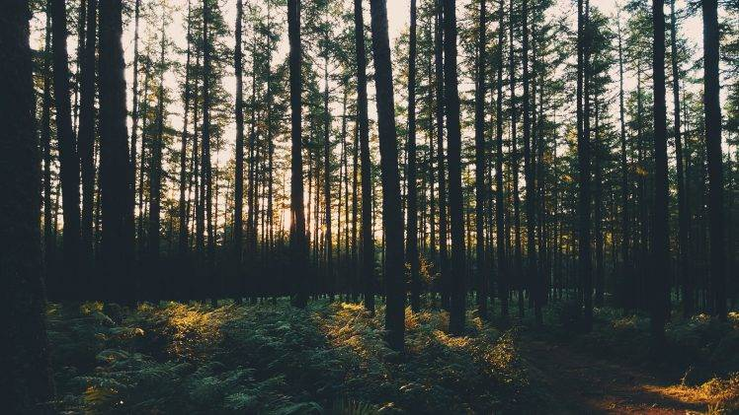

Slide 6
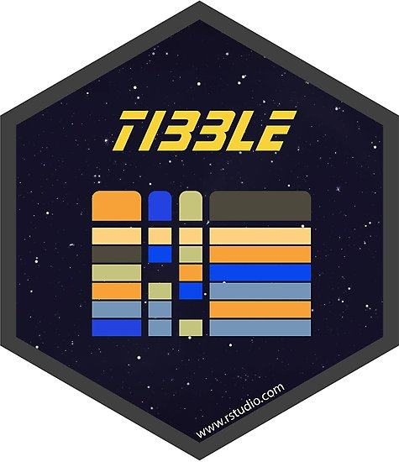



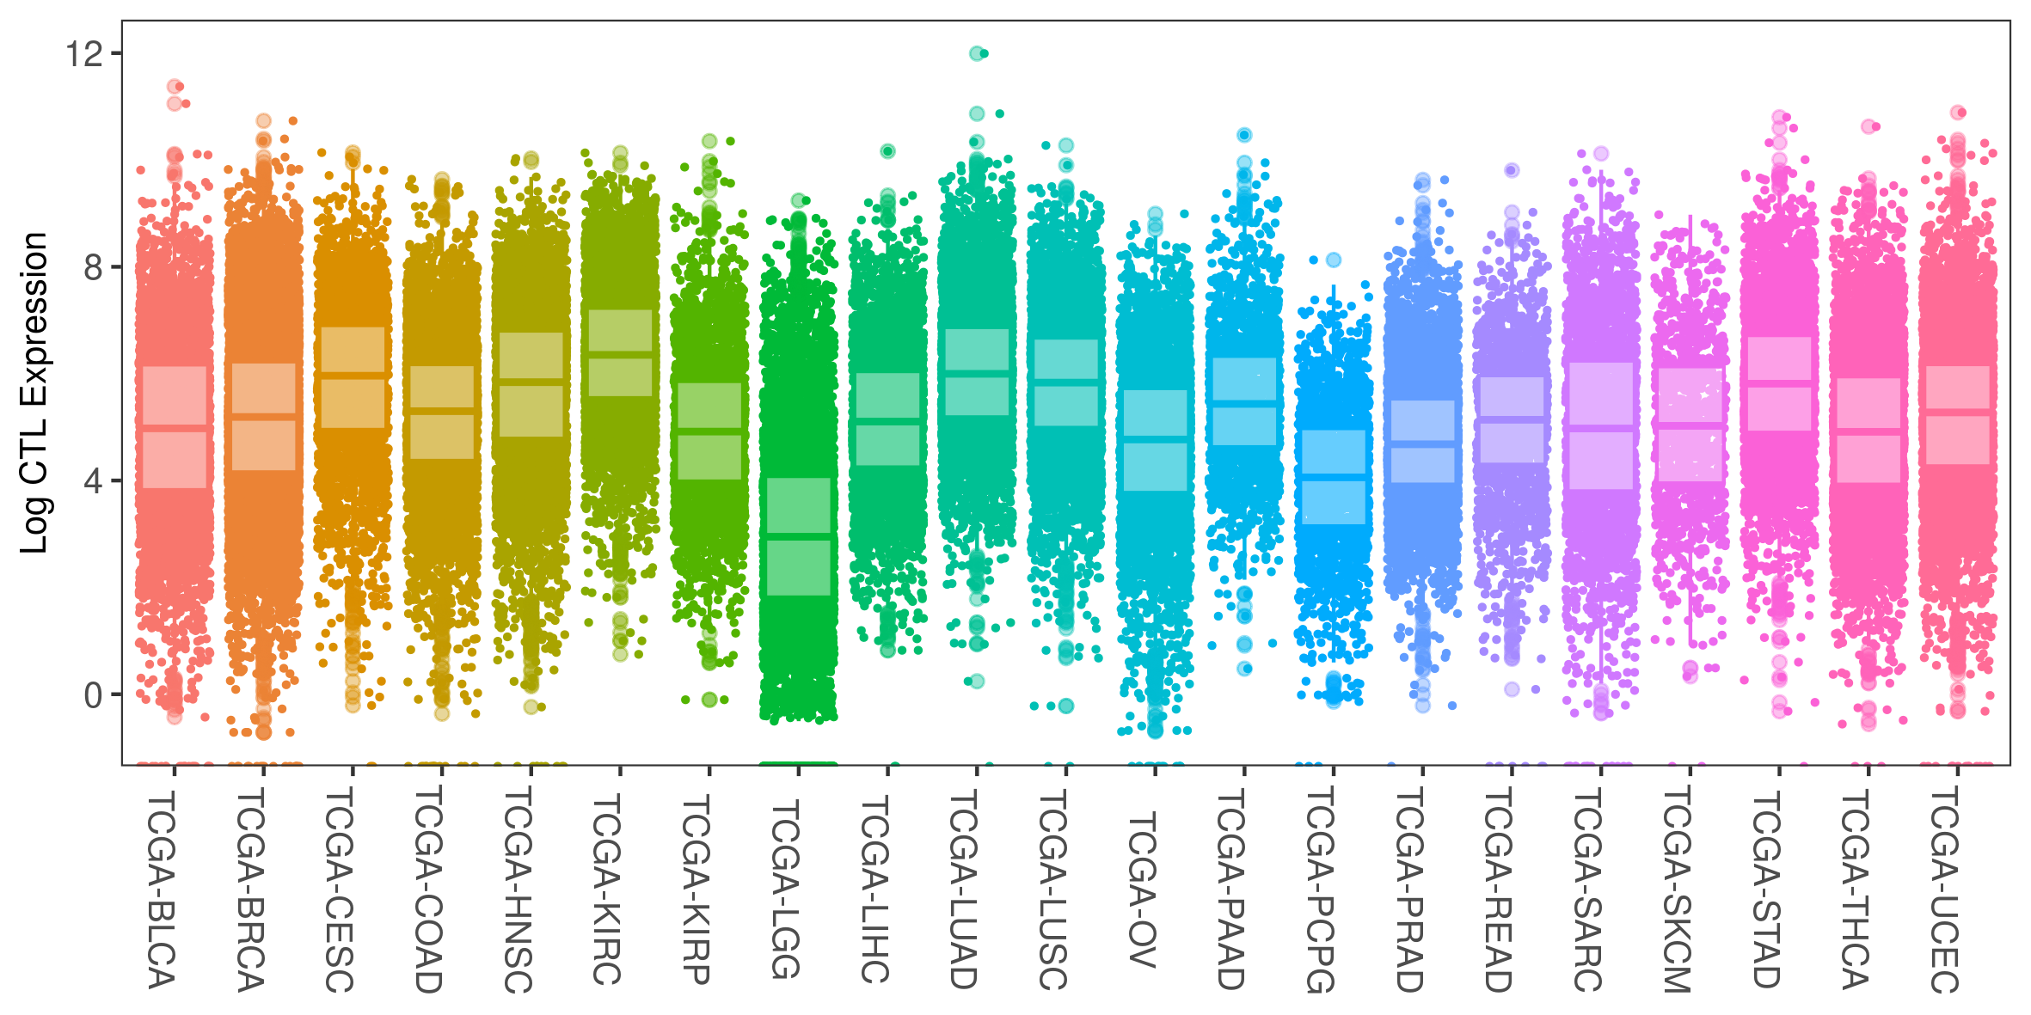
Exploring (Genes)…

Slide 7
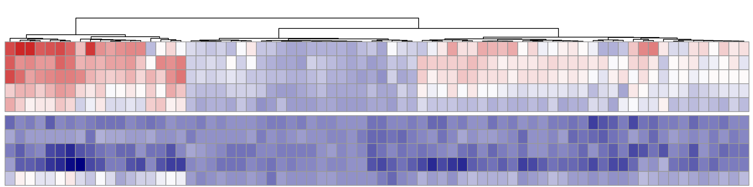
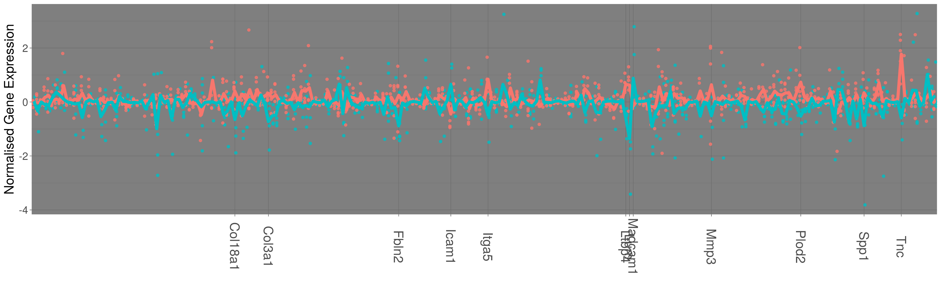
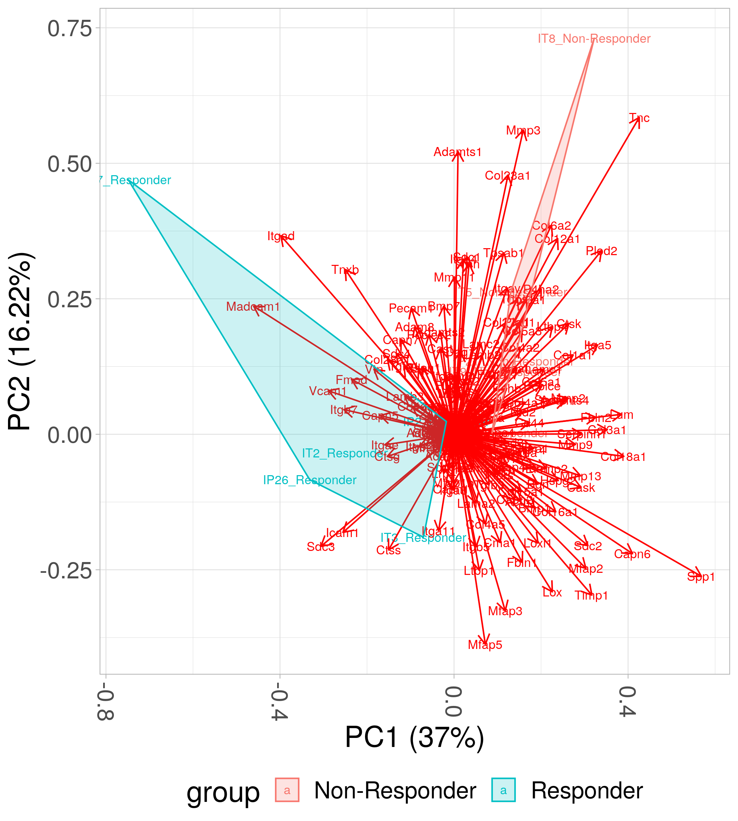
Exploring (Gene lists)…
“pheatmap”
“ggfortify”

Slide 8


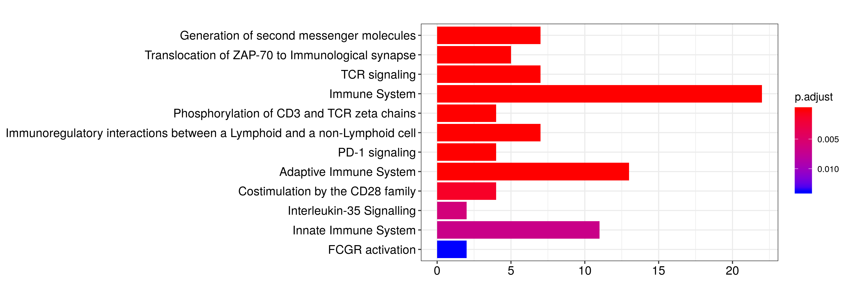
Exploring (Pathways)…

Slide 9
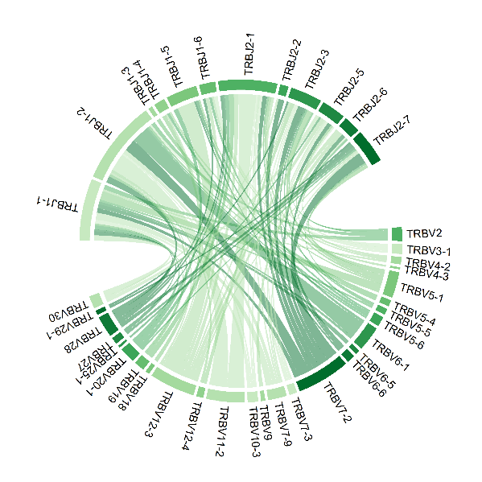

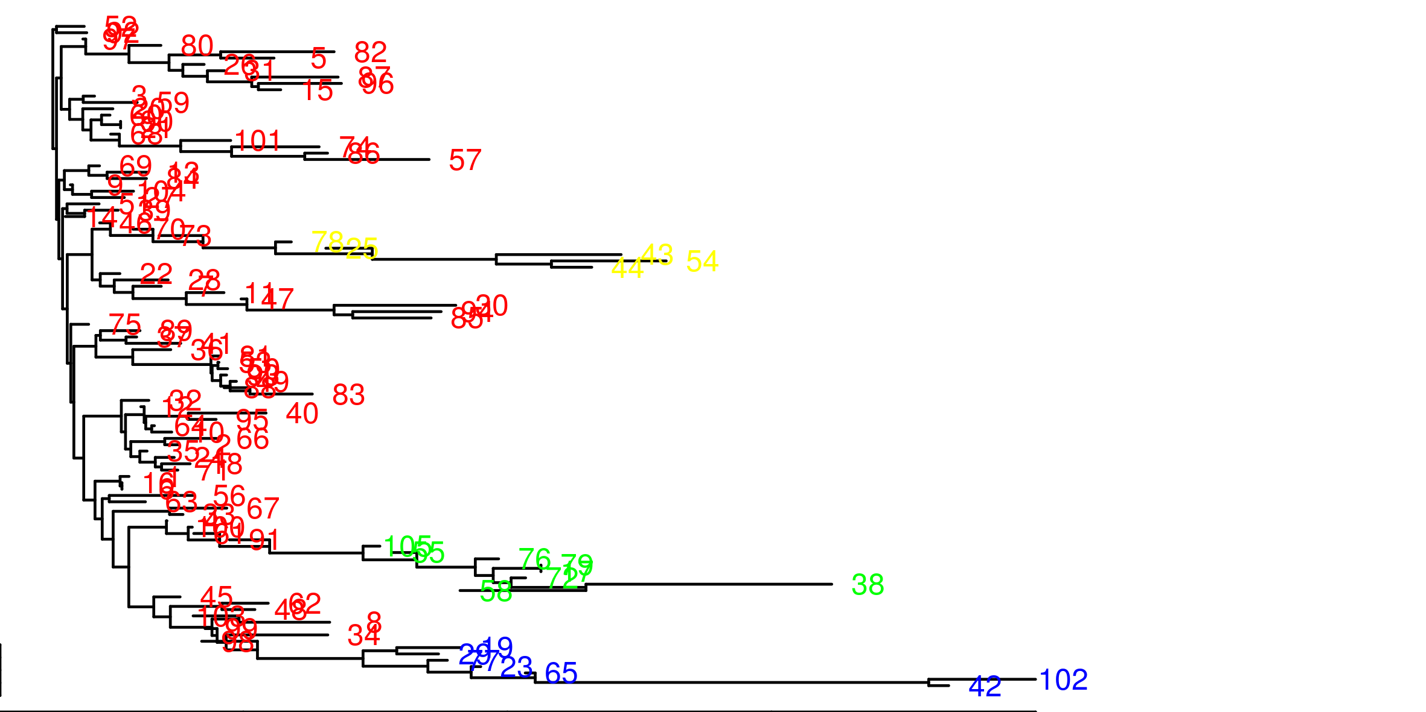
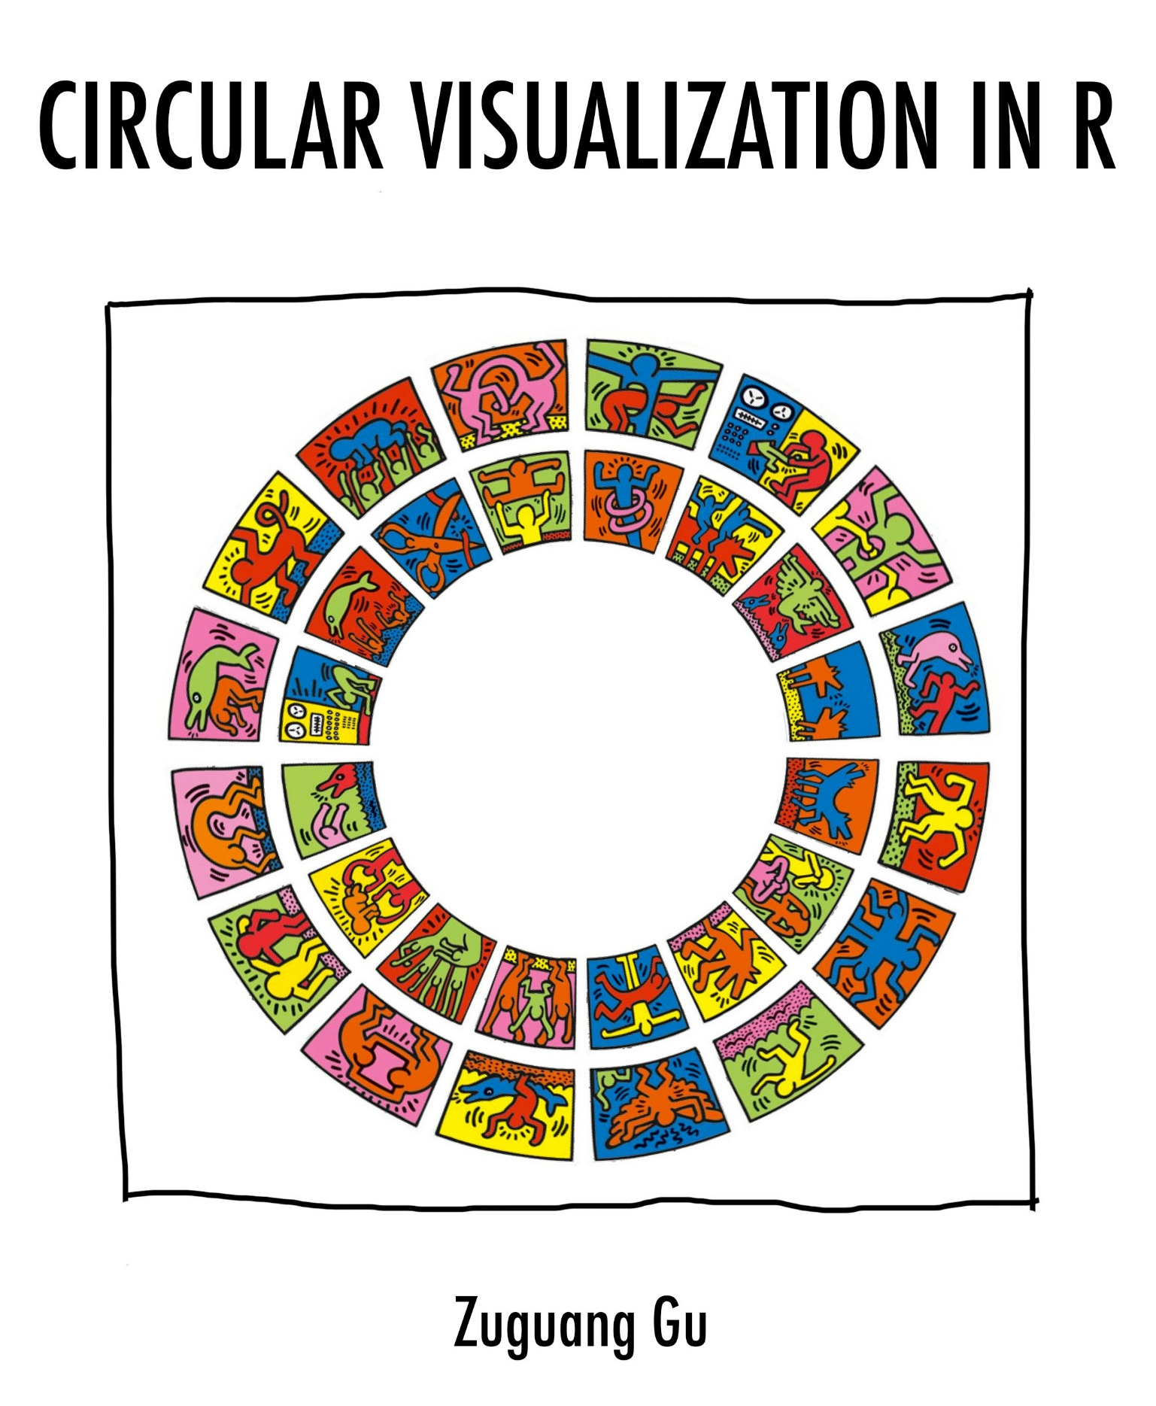
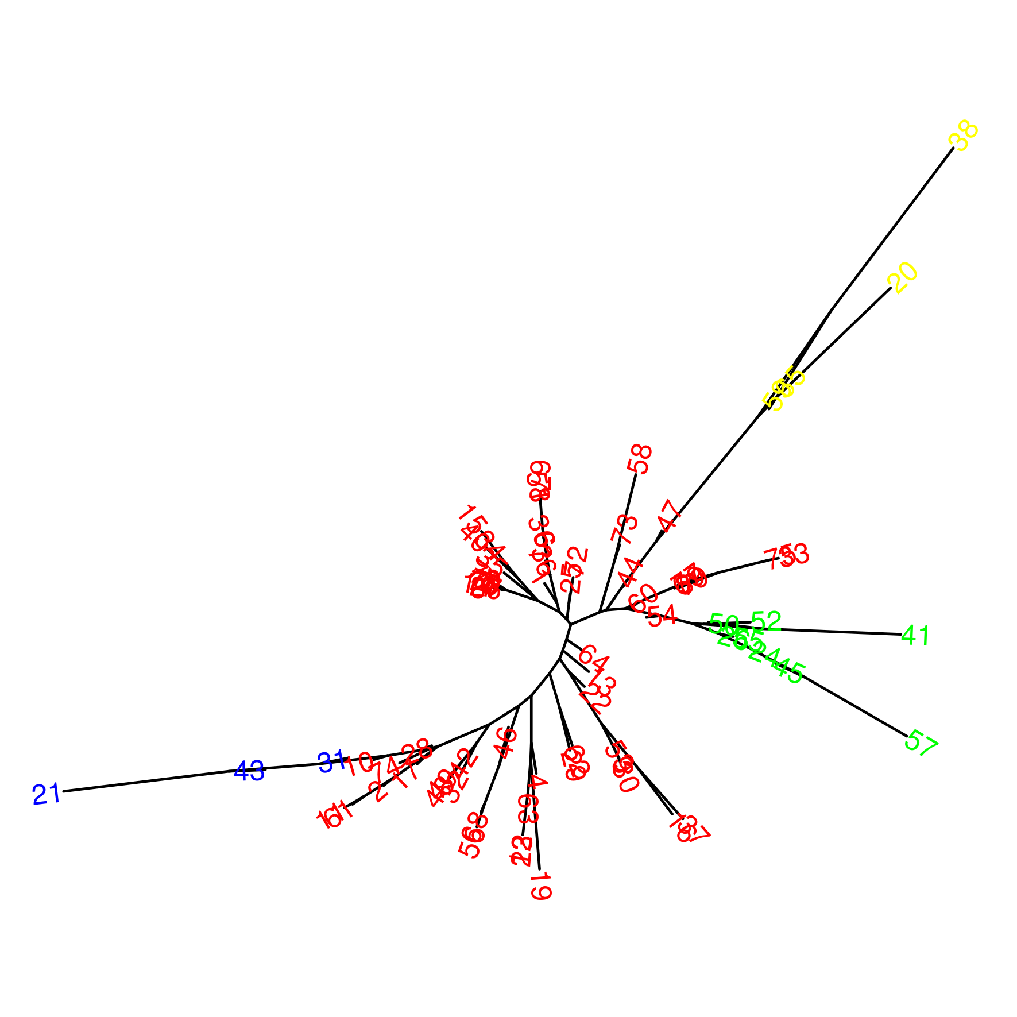
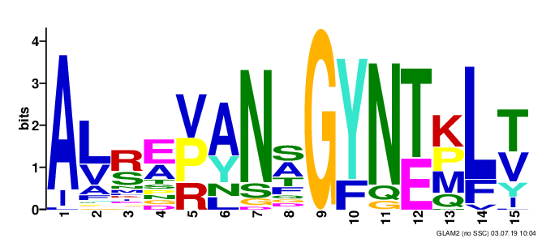
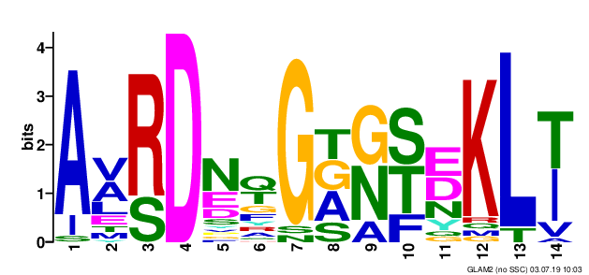
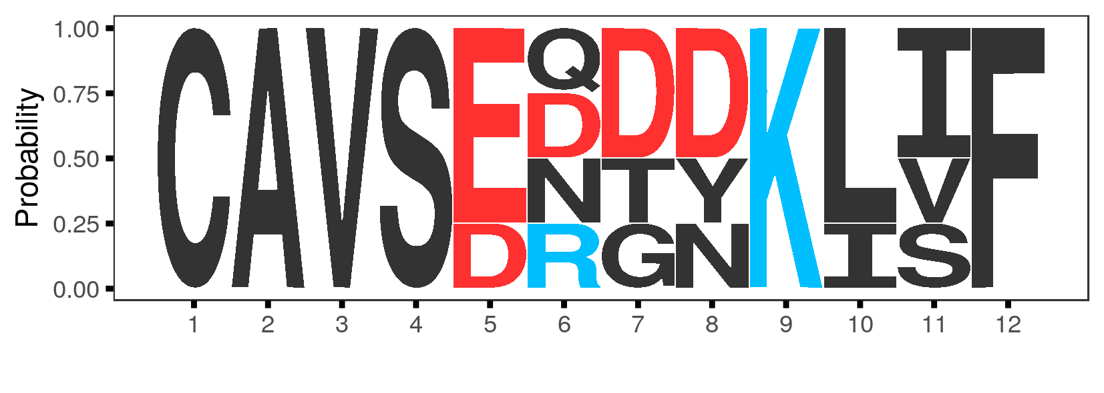
Exploring (Receptors)…
“ggseqlogo”
“phylogram”
“ape”

Slide 10
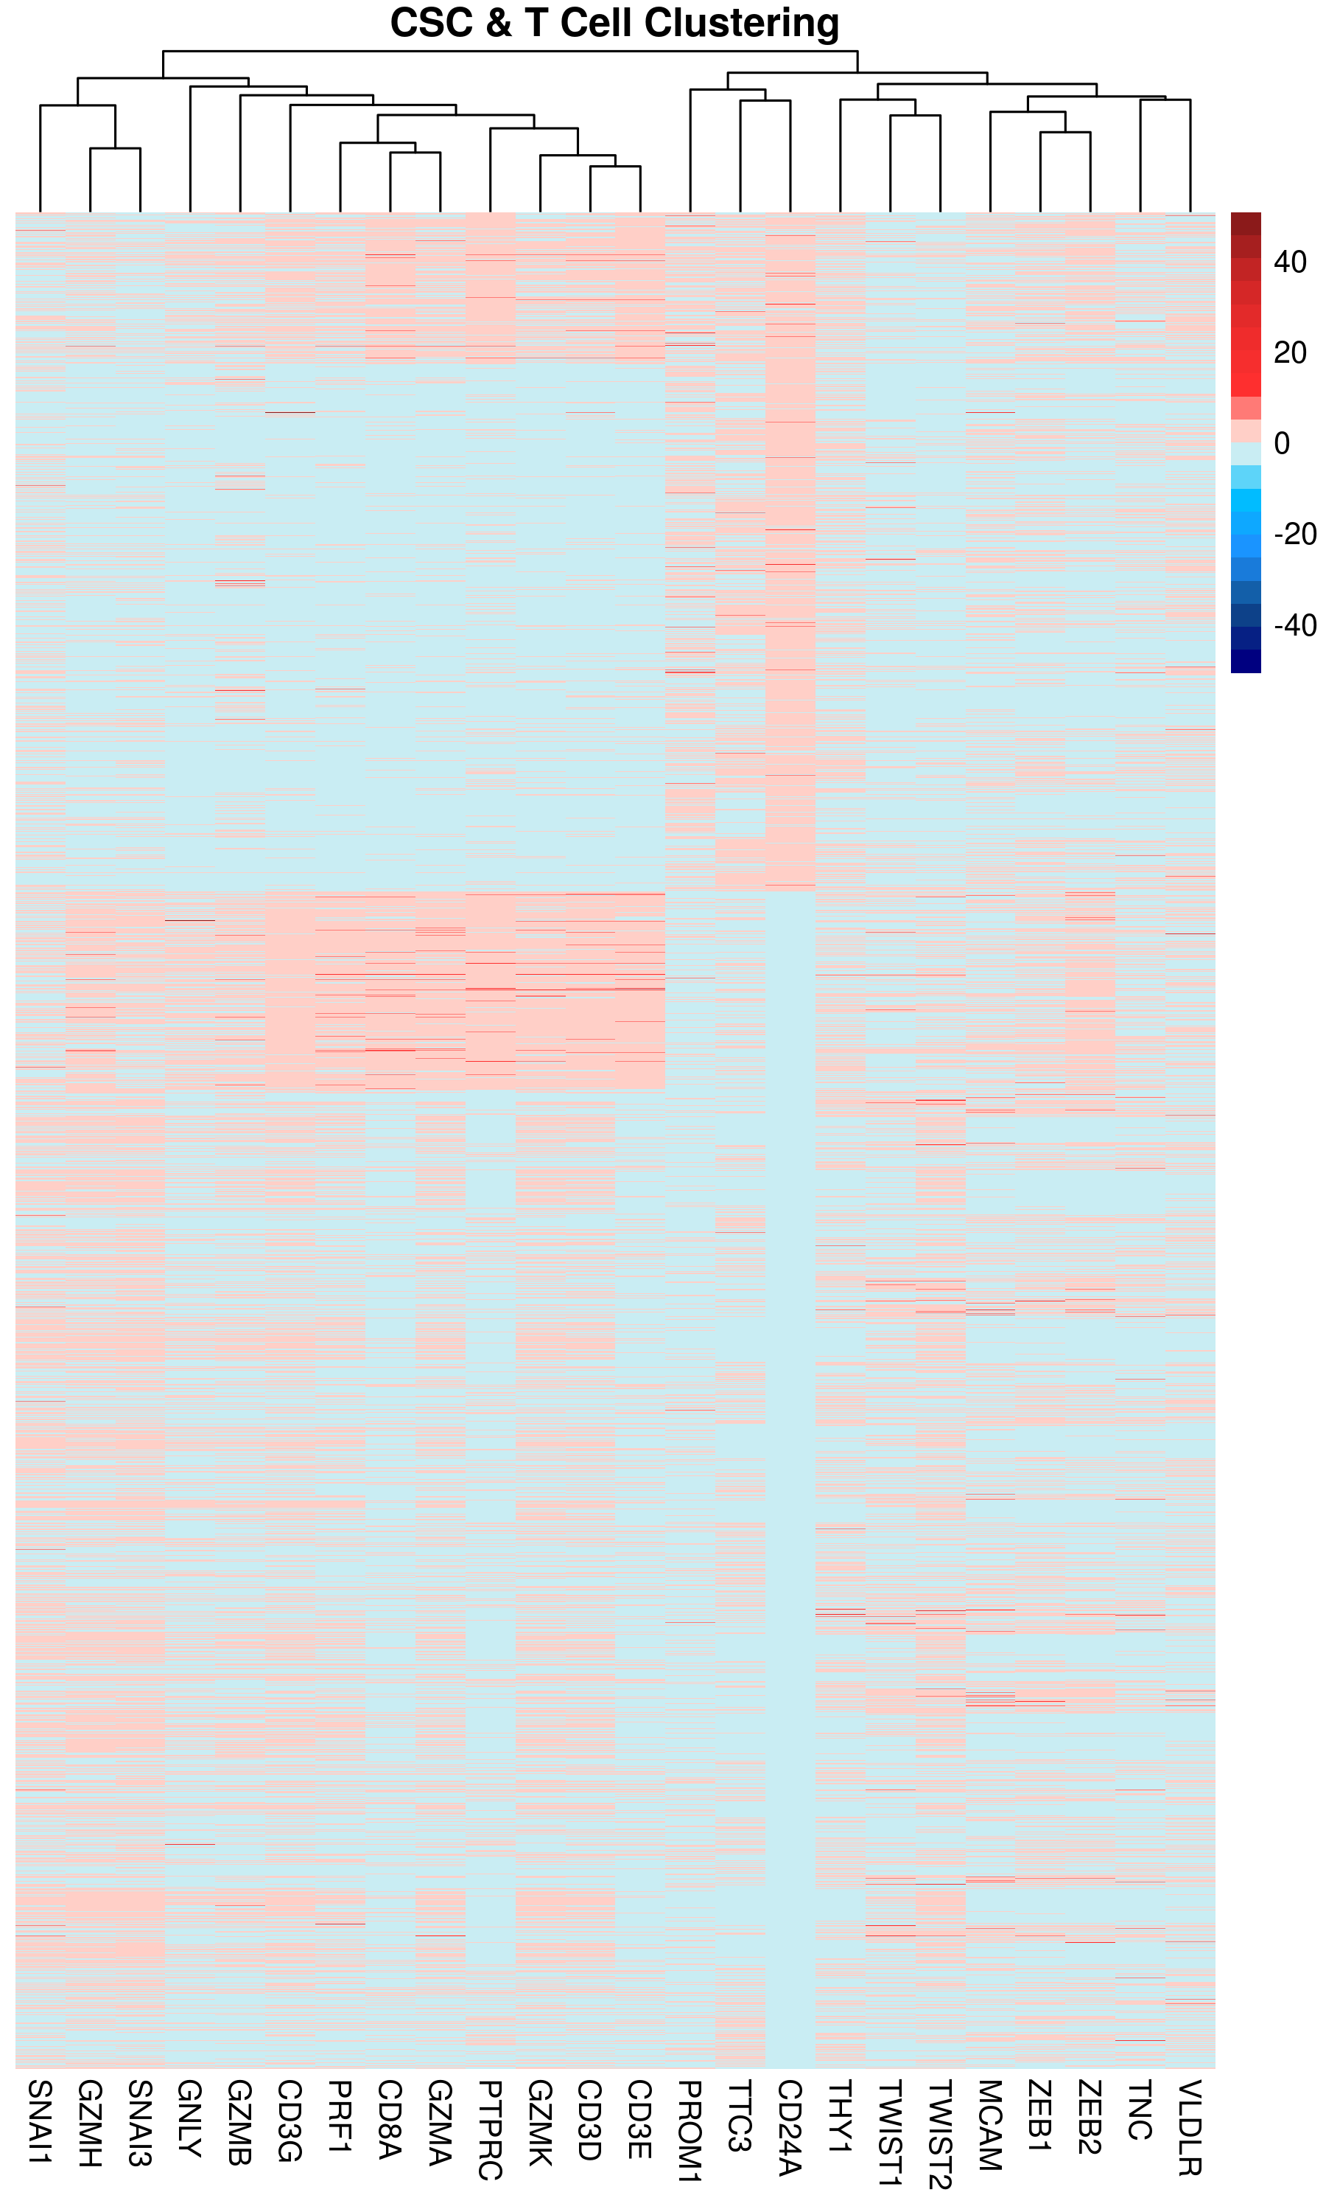
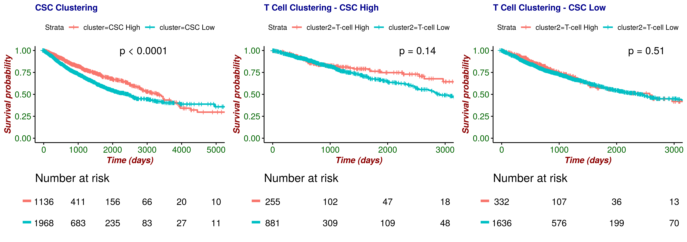
Understanding…
Patients
“pheatmap”
“clusterR”
“parallelDist”
Genes
“ggsurvplot” & “survminer”

Slide 11
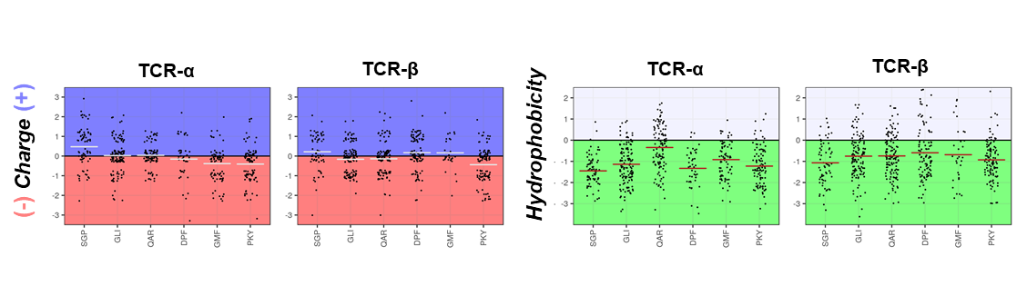
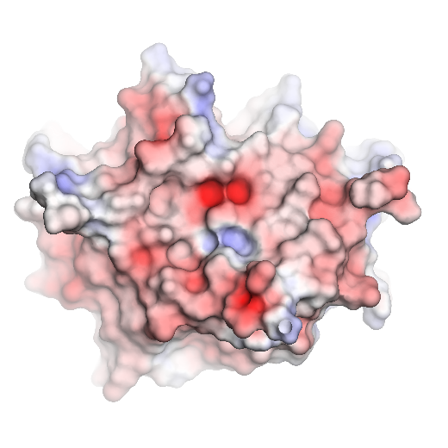
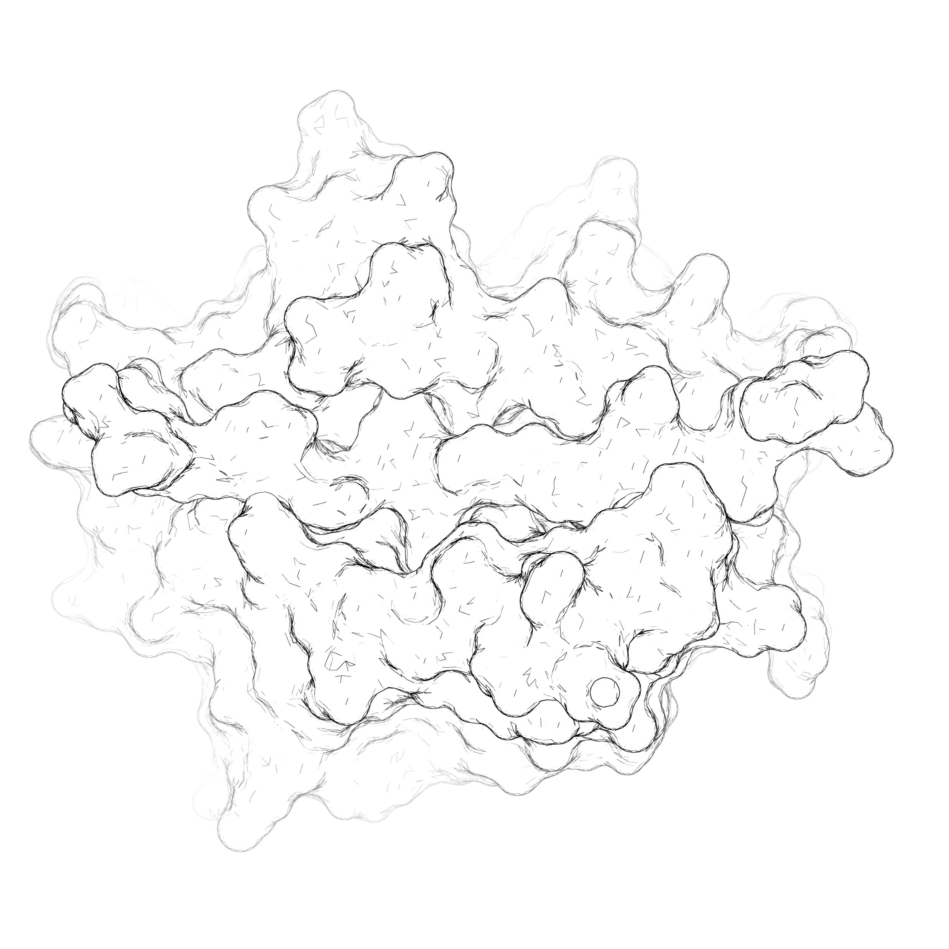
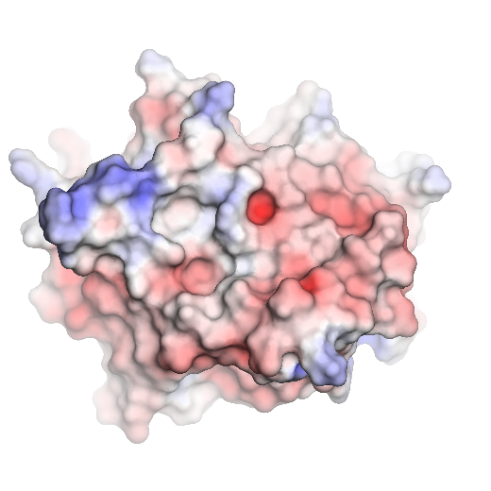
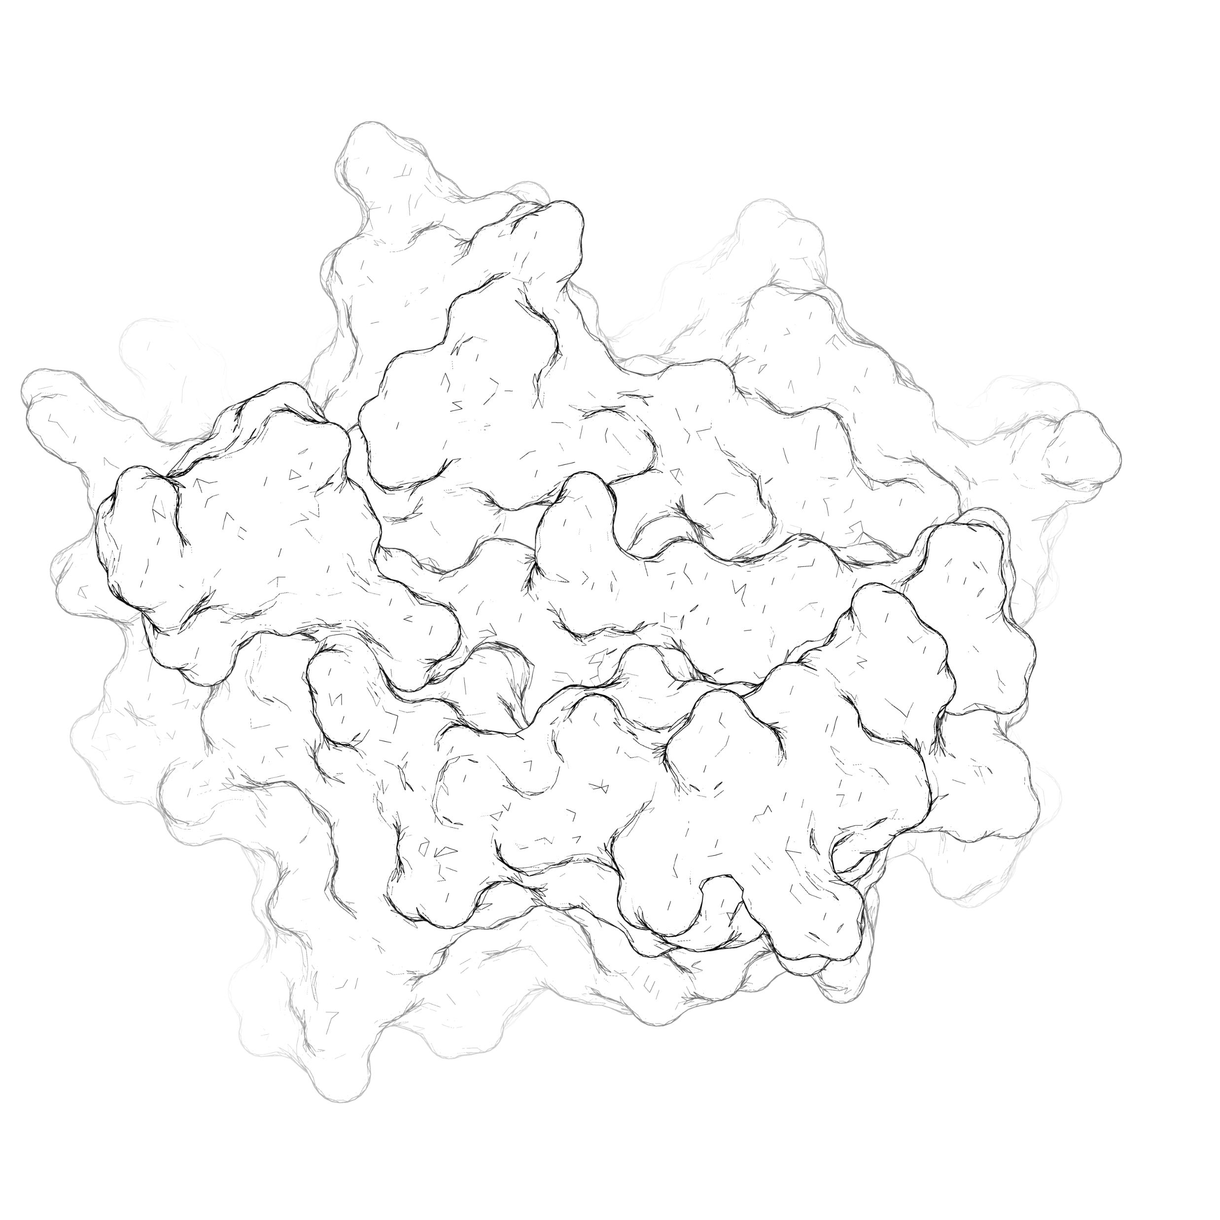
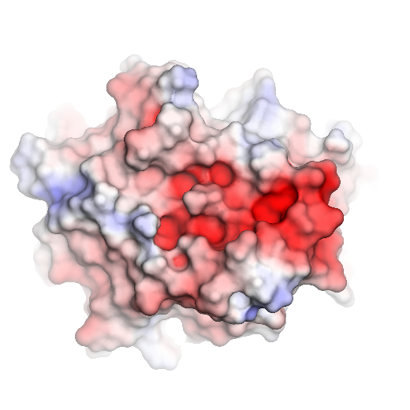
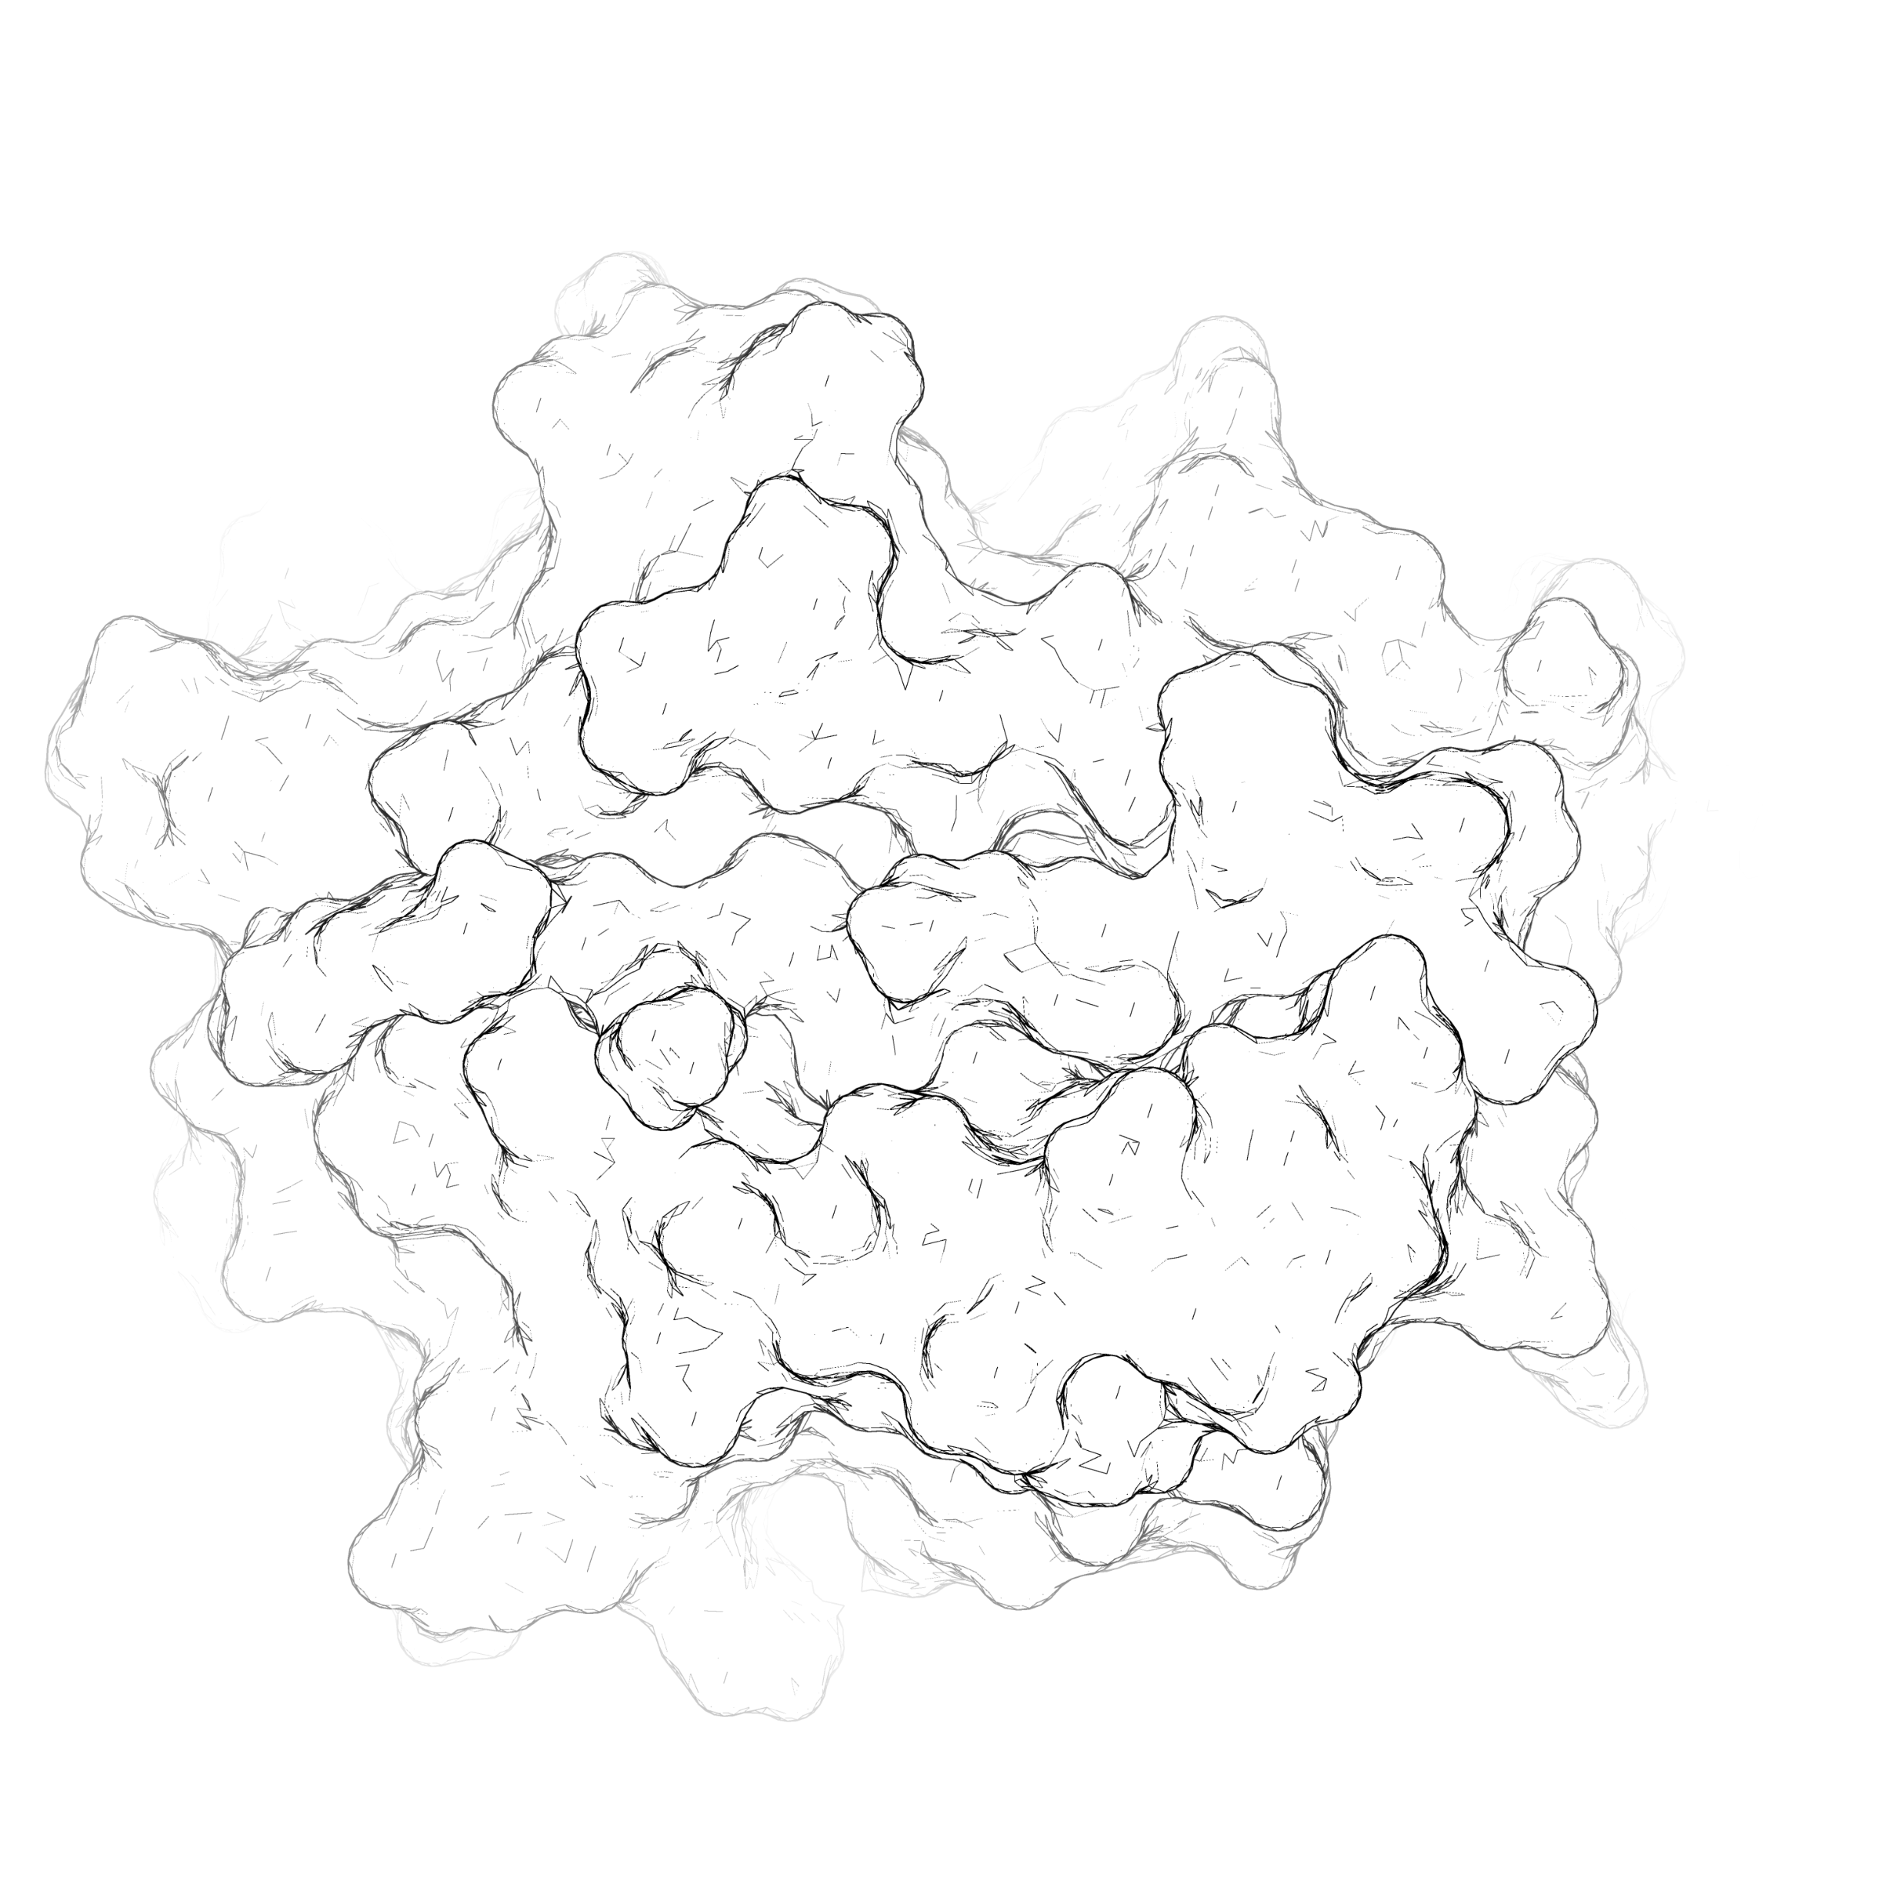
Understanding…

Slide 12
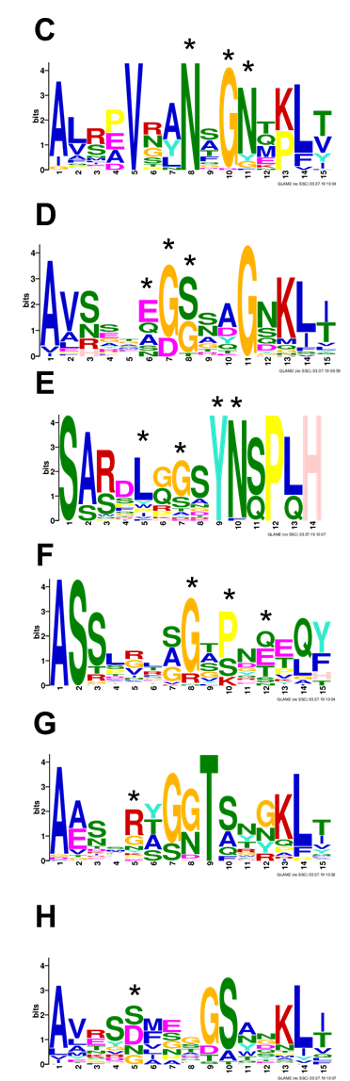
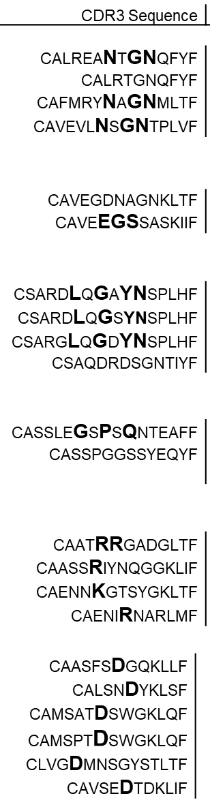


Understanding…

Slide 13

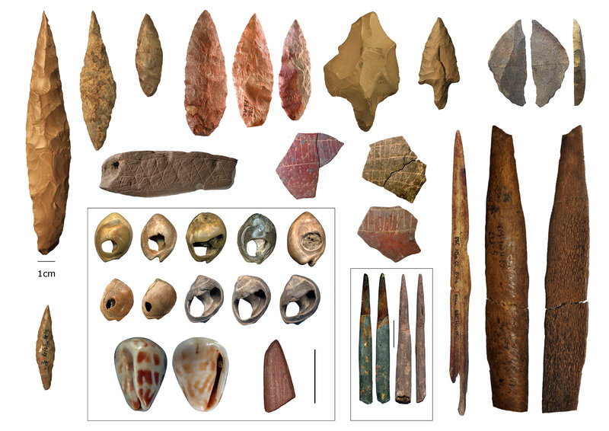

Bottom Line

Slide 14
Thank You ☺
Questions please…

